Slide 1

Frequency-Domain Representations

Slide 2
Contents
Discrete-Time Fourier Analysis
Short-Time Fourier Analysis
Overlap Addition Method of Synthesis
Time-Decimated Filter Banks
Two-Channel Filter Banks

Slide 3
Discrete-Time Fourier Analysis

Slide 4
Discrete-Time Fourier Analysis
Basics of Fourier Transform
Definition
Fourier Transform converts a time-domain signal into its frequency-domain representation.
Essential for analyzing the frequency content of signals.

Slide 5
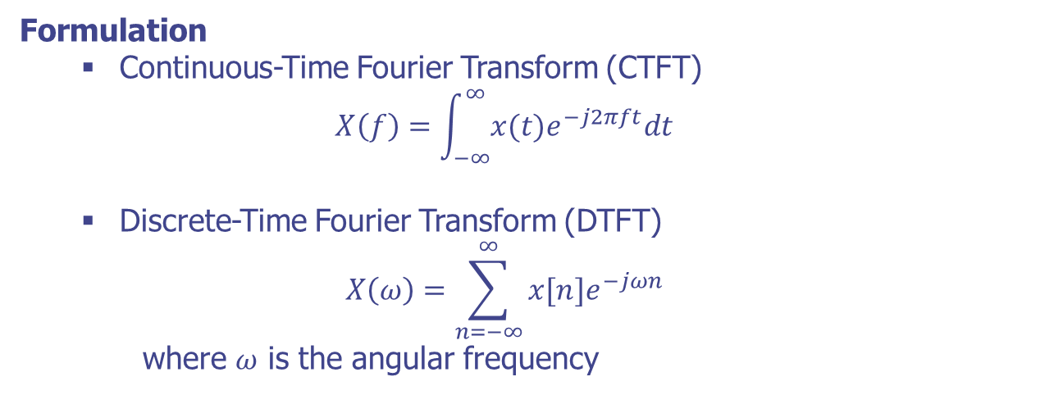
Discrete-Time Fourier Analysis
Basics of Fourier Transform

Slide 6
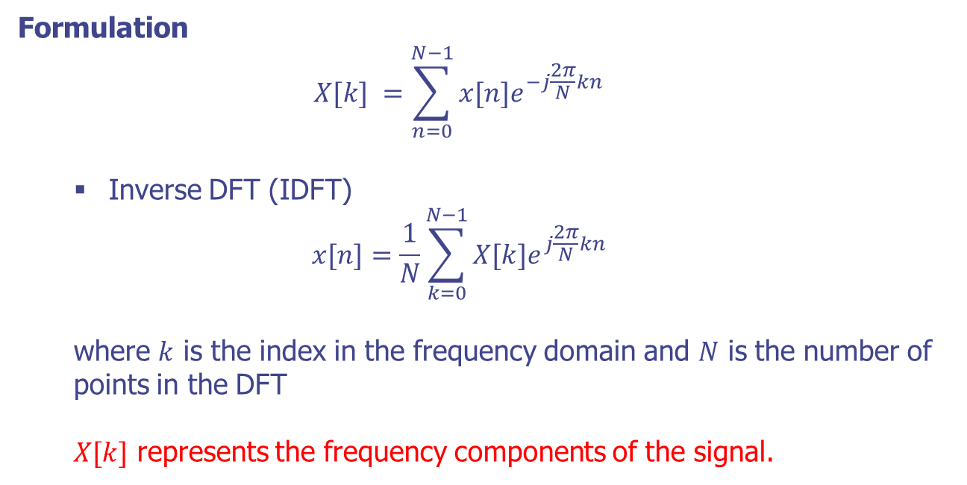
Discrete-Time Fourier Analysis
Discrete Fourier Transform (DFT)

Slide 7
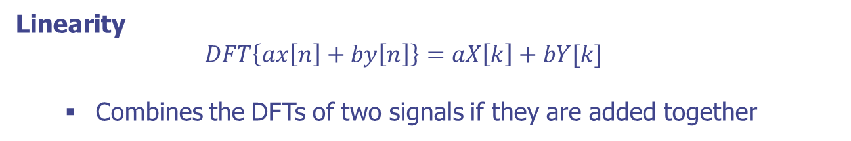
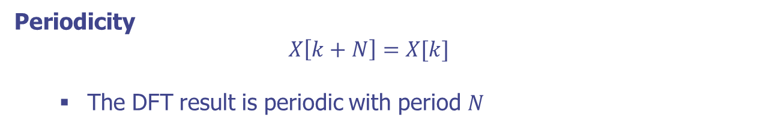
Discrete-Time Fourier Analysis
Properties of DFT

Slide 8
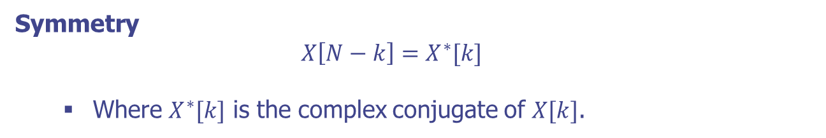
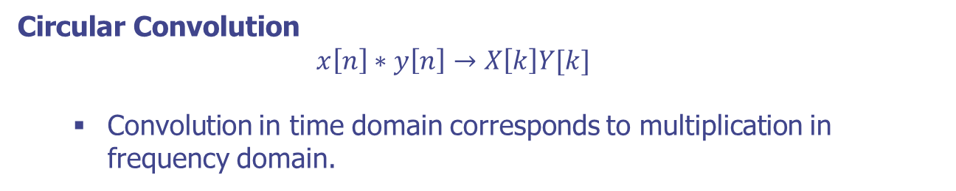
Discrete-Time Fourier Analysis
Properties of DFT (cont.)

Slide 9
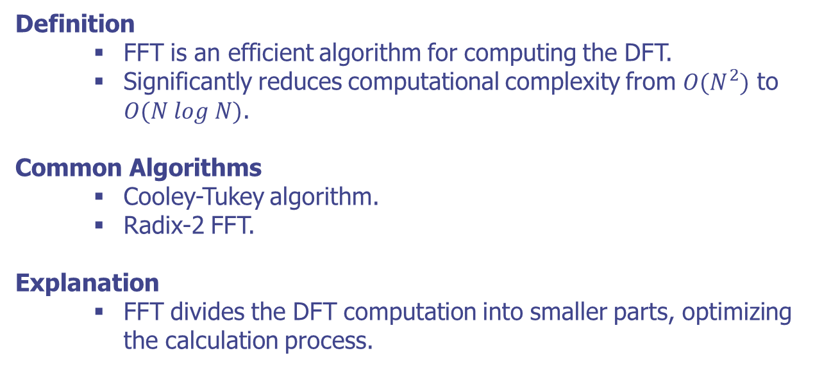
Discrete-Time Fourier Analysis
Fast Fourier Transform (FFT)

Slide 10
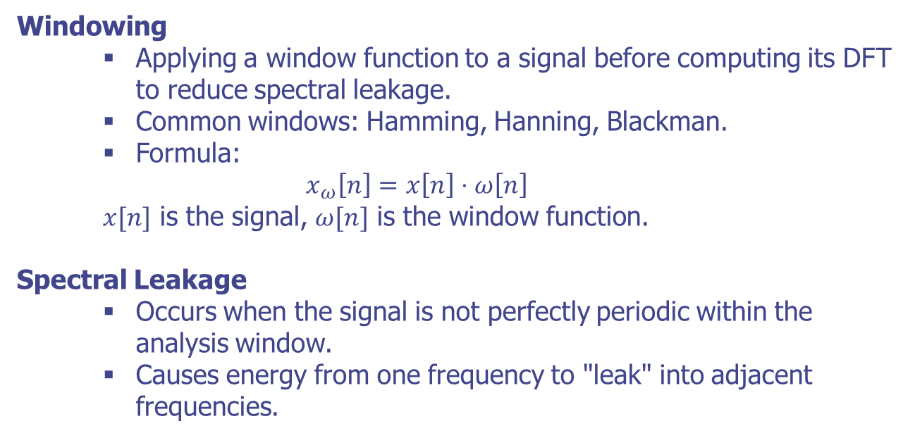
Discrete-Time Fourier Analysis
Windowing and Spectral Leakage

Slide 11
Discrete-Time Fourier Analysis
Practical Implementation in Python
Python Libraries
NumPy: Numerical computations.
Matplotlib: Visualization.
SciPy: Signal processing.
Steps:
Generate or load a speech signal.
Apply windowing to the signal.
Compute the DFT using FFT.
Visualize the magnitude and phase spectrum.

Slide 12
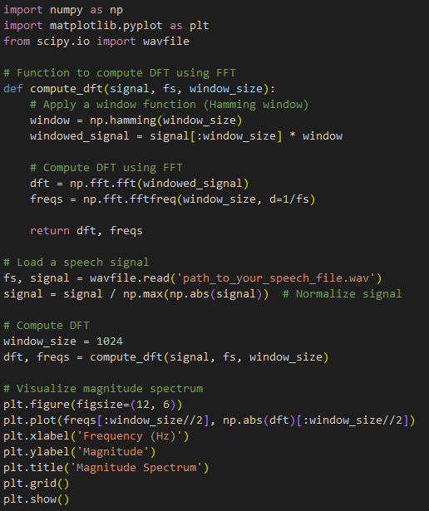
Discrete-Time Fourier Analysis
Practical Implementation in Python

Slide 13
Discrete-Time Fourier Analysis
Summary
DFT is a powerful tool for frequency-domain analysis of discrete signals.
FFT makes DFT computation efficient and practical for real-time applications.
Windowing techniques help mitigate spectral leakage, improving analysis accuracy.
DFT and FFT are fundamental in various speech processing tasks, from analysis to synthesis.

Slide 14
Short-Time Fourier Analysis

Slide 15
Short-Time Fourier Analysis
Fourier Transform and its Limitations
Fourier Transform:
Converts a signal from the time domain to the frequency domain.
Provides global frequency information but lacks time localization.
Limitations:
Not suitable for non-stationary signals like speech.
Loses information about when specific frequency components occur.
Need for Time-Frequency Analysis:
Capture both time and frequency information.
Suitable for analyzing speech signals which are non-stationary.

Slide 16
Short-Time Fourier Analysis
Concept of Short-Time Fourier Transform (STFT)
Definition
STFT divides a signal into short segments and applies Fourier Transform to each segment.
Provides a time-localized frequency analysis.

Slide 17
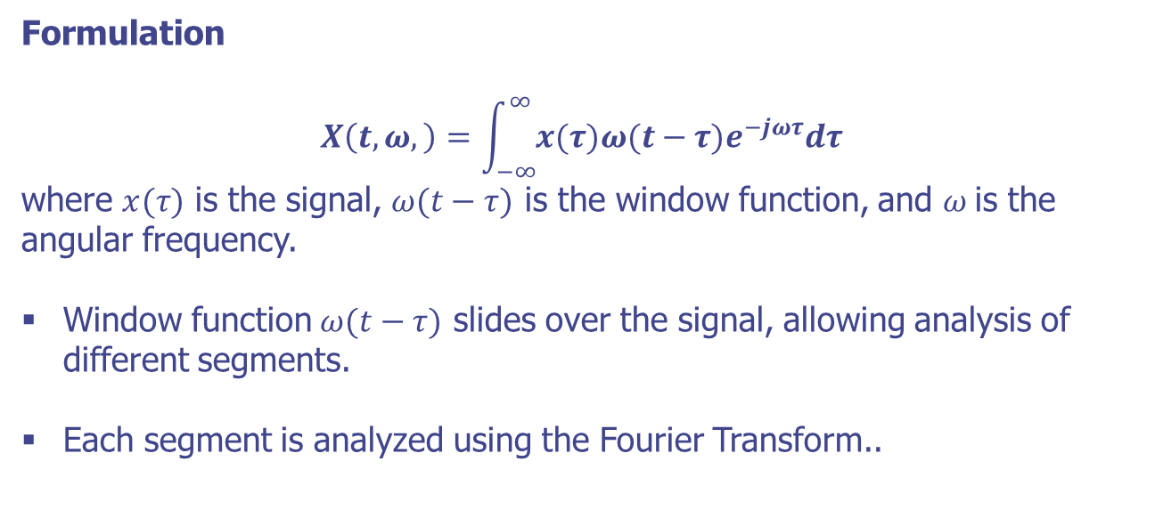
Short-Time Fourier Analysis
Concept of Short-Time Fourier Transform (STFT)

Slide 18
Short-Time Fourier Analysis
Window Function in STFT
Window Function
Essential for segmenting the signal.
Common types: Rectangular, Hamming, Hanning, Blackman.
Impact of Window Choice
Rectangular Window: Sharp edges, high spectral leakage.
Hamming Window: Reduces spectral leakage, smoother edges.
Hanning Window: Similar to Hamming, but different tapering.
Blackman Window: More tapering, less spectral leakage.

Slide 19
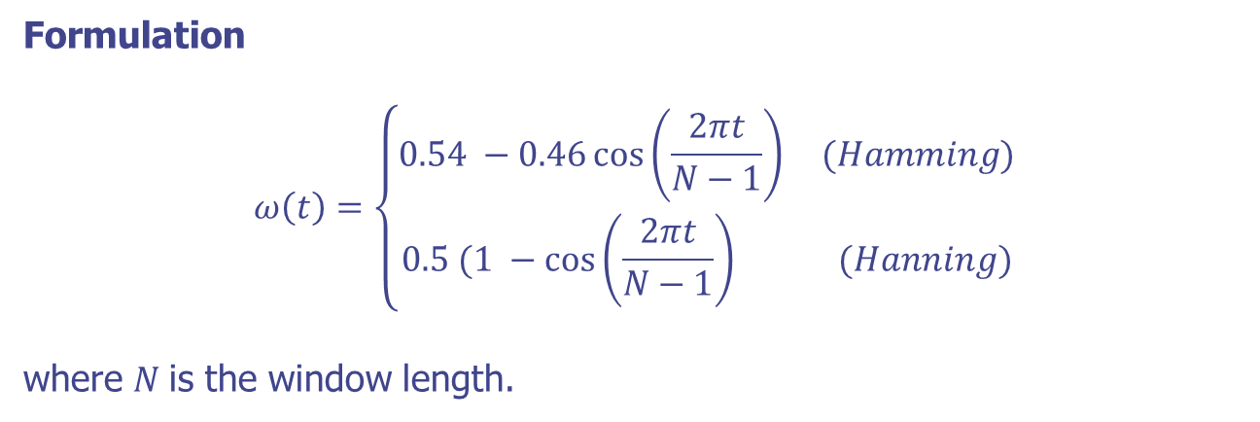
Short-Time Fourier Analysis
Window Function in STFT

Slide 20
Short-Time Fourier Analysis
STFT Implementation Steps
Steps
Divide the signal into overlapping frames.
Apply a window function to each frame.
Compute the Fourier Transform for each frame.
Combine the results to form the time-frequency representation.
Parameters
Window Size: Affects frequency resolution.
Overlap: Affects time resolution.
FFT Points: Determines the frequency bins.

Slide 21
Short-Time Fourier Analysis
Practical Implementation in Python
Python Libraries
NumPy: Numerical computations.
Matplotlib: Visualization.
SciPy: Signal processing..
Steps
Load a speech signal.
Apply windowing to the signal.
Compute the STFT.
Visualize the spectrogram..

Slide 22
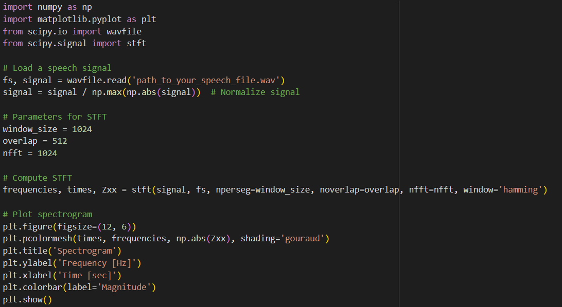
Short-Time Fourier Analysis
Practical Implementation in Python

Slide 23
Short-Time Fourier Analysis
Summary
STFT provides a powerful tool for time-frequency analysis of non-stationary signals like speech.
Choice of window and overlap significantly affects the analysis.
Practical implementation involves balancing time and frequency resolution.

Slide 24
Overlap Addition Method of Synthesis

Slide 25
Overlap Addition Method of Synthesis
Introduction
Definition
The Overlap-Add method is a technique for reconstructing a signal from its short-time segments.
Used in signal processing to achieve time-domain synthesis from frequency-domain modifications.
Explanation
Involves dividing the signal into overlapping frames, processing each frame, and then recombining them.

Slide 26
Overlap Addition Method of Synthesis
Formulation of Overlap-Add (OLA)
Step-by-Step Process
Frame Division: Divide the input signal x[n]x[n] into overlapping frames.
Windowing: Apply a window function w[n]w[n] to each frame to mitigate edge effects.
Frequency Domain Processing: Transform each windowed frame to the frequency domain, modify as needed.
Inverse Transform: Transform each modified frame back to the time domain.
Overlap and Add: Sum the overlapping segments to reconstruct the signal.

Slide 27
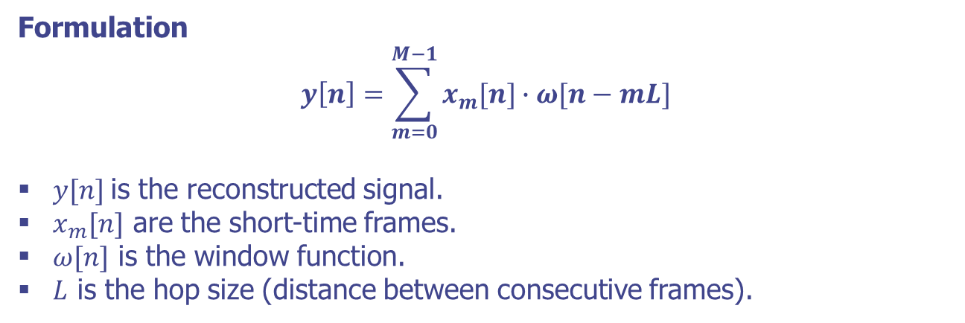
Overlap Addition Method of Synthesis
Formulation of Overlap-Add (OLA)

Slide 28
Overlap Addition Method of Synthesis
Steps in Overlap-Add Synthesis
Frame the Signal: Divide the input signal into overlapping frames.
Window Each Frame: Apply a window function to each frame.
Apply STFT: Transform each frame to the frequency domain.
Modify Each Frame: Perform desired modifications in the frequency domain.
Apply ISTFT: Convert each modified frame back to the time domain.
Overlap and Add: Reconstruct the signal by overlapping and adding the frames.

Slide 29
Overlap Addition Method of Synthesis
Practical Implementation in Python
Python Libraries:
NumPy: Numerical computations.
SciPy: Signal processing.
Matplotlib: Visualization.
Steps:
Load a speech signal.
Divide the signal into overlapping frames.
Apply STFT to each frame.
Modify the frequency domain representation.
Apply ISTFT to each frame.
Reconstruct the signal by overlapping and adding the frames.

Slide 30
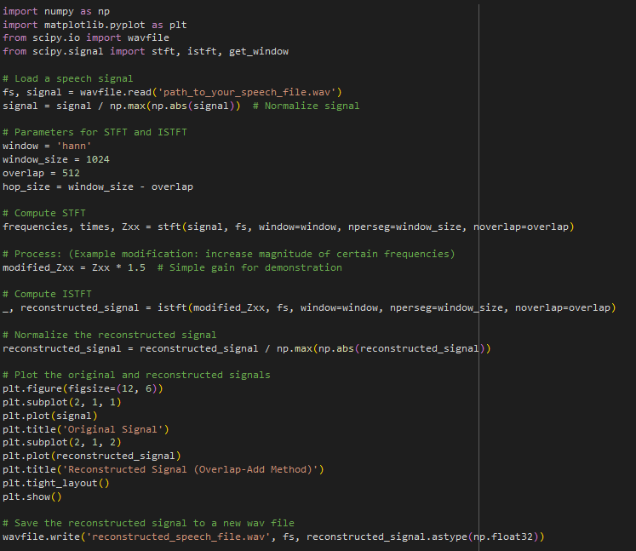
Overlap Addition Method of Synthesis
Practical Implementation in Python

Slide 31
Overlap Addition Method of Synthesis
Summary
Key Points
Overlap-Add method is essential for reconstructing signals from modified short-time frames.
Balances time-domain synthesis and frequency-domain modifications.
Widely used in various speech processing applications.
Future Directions
Combining OLA with advanced techniques like Wavelet Transform.
Research on more efficient and high-quality synthesis methods.

Slide 32
Time-Decimated Filter Banks

Slide 33
Time-Decimated Filter Banks
Basics of Filter Banks
Definition
Filter banks are collections of band-pass filters that decompose a signal into multiple components, each representing a specific frequency band.
Explanation
Used to analyze the signal in different frequency bands.
Important in speech processing for tasks like compression, feature extraction, and synthesis.

Slide 34
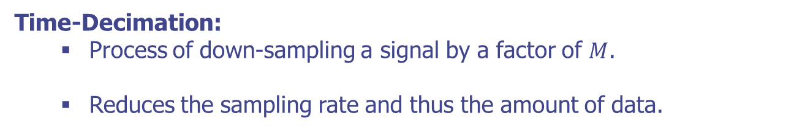
Time-Decimated Filter Banks
Concept of Time-Decimation
Purpose
Decrease computational load.
Focus on specific frequency bands of interest.

Slide 35
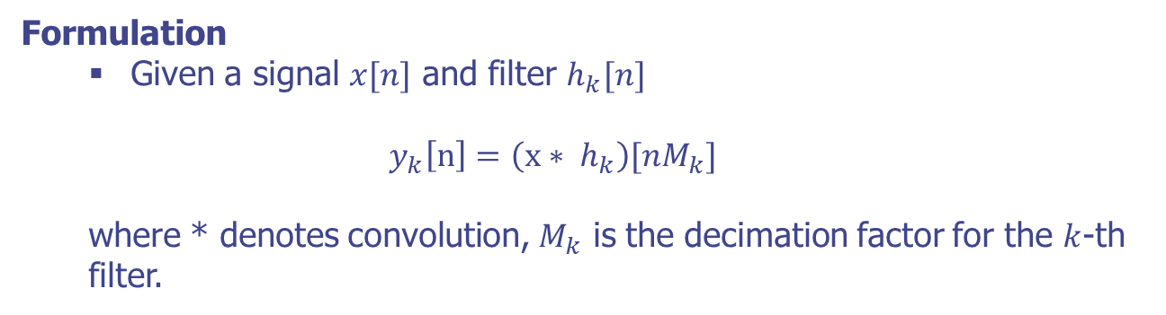
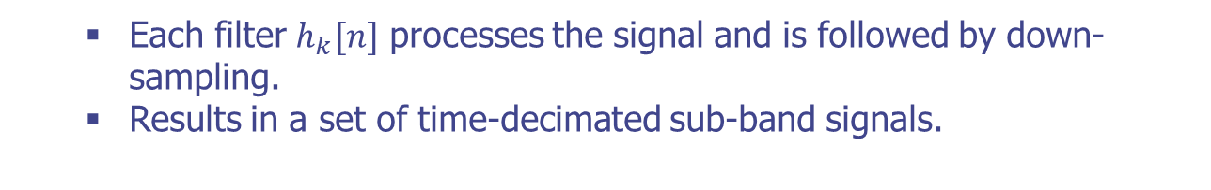
Time-Decimated Filter Banks
Time-Decimated Filter Banks
Definition
A filter bank where each filter output is decimated by a specific factor.
Each filter $h_{k}[n]$ processes the signal and is followed by down-sampling.
Results in a set of time-decimated sub-band signals.

Slide 36
Time-Decimated Filter Banks
Design of Time-Decimated Filter Banks
Filter Design: Typically designed using windowing techniques or optimization methods.
Prototype Filter: A prototype low-pass filter is designed and modulated to create the filter bank.
Frequency Response: Filters are designed to have non-overlapping or minimally overlapping passbands.

Slide 37
Time-Decimated Filter Banks
Practical Implementation in Python
Python Libraries:
NumPy: Numerical computations.
SciPy: Signal processing.
Matplotlib: Visualization.
Steps:
Design the prototype filter.
Modulate the prototype filter to create the filter bank.
Apply the filter bank to the signal.
Down-sample the filter outputs.

Slide 38
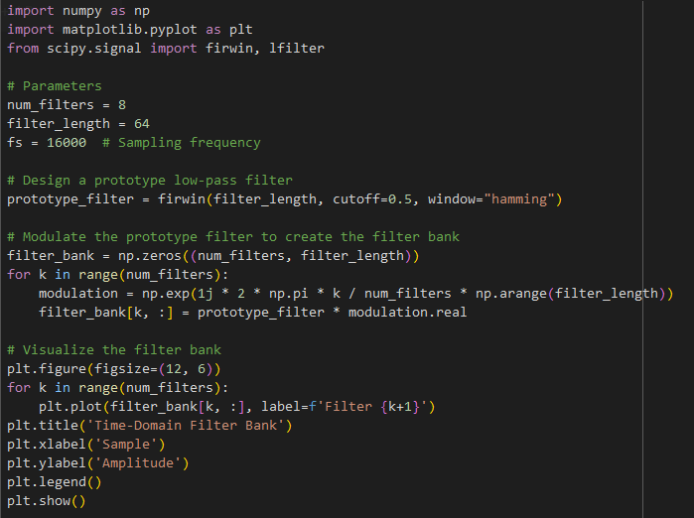
Time-Decimated Filter Banks
Practical Implementation in Python

Slide 39
Time-Decimated Filter Banks
Summary
Key Points
Time-Decimated Filter Banks are essential for efficient signal analysis and processing.
Combines filter design and decimation for computational efficiency.
Widely used in various speech processing applications.
Future Directions
Development of more advanced filter bank designs.
Integration with machine learning for adaptive filtering.

Slide 40
Two-Channel Filter Banks

Slide 41
Two-Channel Filter Banks
Structure of Two-Channel Filter Banks
Components
Analysis Filters: Split the input signal into low-frequency (low-pass) and high-frequency (high-pass) components.
Downsamplers: Reduce the sample rate of each sub-band by a factor of 2.
Synthesis Filters: Reconstruct the signal from the sub-bands.
Upsamplers: Increase the sample rate of each sub-band by a factor of 2 before synthesis.

Slide 42
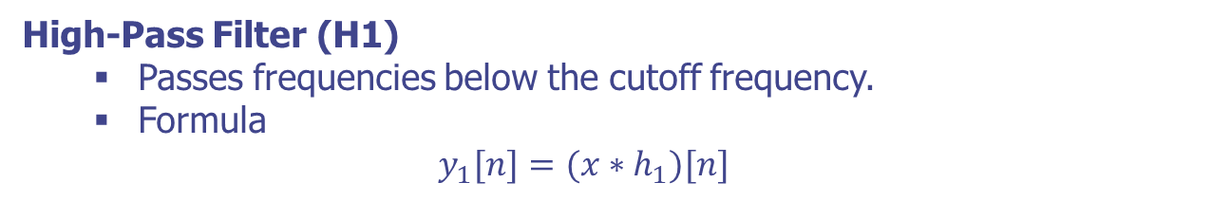

Two-Channel Filter Banks
Analysis Filter Bank
Low-Pass Filter (H0)
Passes frequencies below the cutoff frequency.
Formula
$$y_{0}[n]=(x∗h_{0})[n]$$
High-Pass Filter (H1)
Passes frequencies below the cutoff frequency.
Formula
$$y_{1}[n]=(x∗h_{1})[n]$$
Downsampling: Reduces the data rate by retaining every second sample.

Slide 43
Two-Channel Filter Banks
Synthesis Filter Bank
Upsampling:
Increases the sample rate by inserting zeros between samples.
Low-Pass Synthesis Filter (G0):
Reconstructs the low-frequency components.
High-Pass Synthesis Filter (G1):
Reconstructs the high-frequency components.
Combining:
The outputs of the synthesis filters are added to reconstruct the original signal.

Slide 44
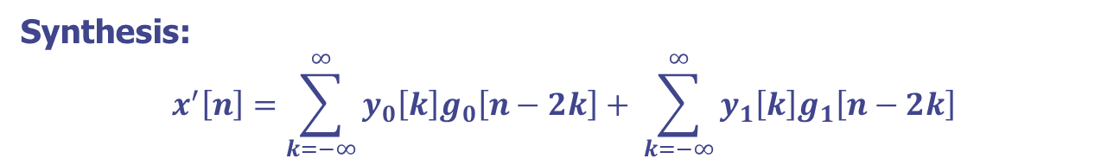
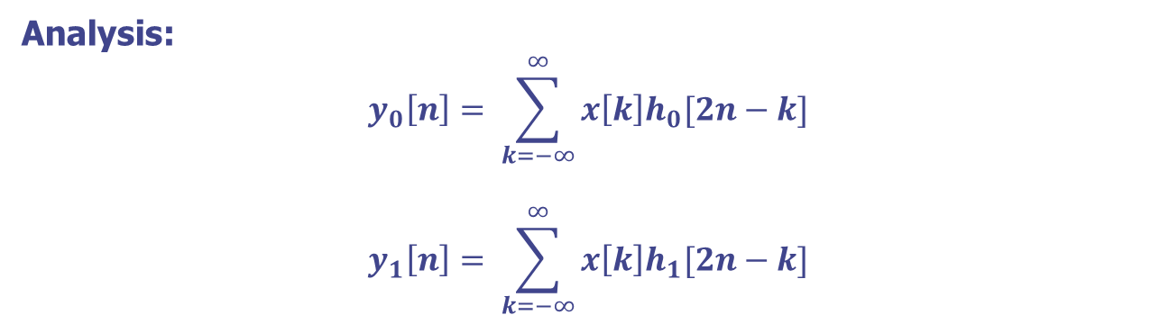
Two-Channel Filter Banks
Methamatical Formulation
Analysis:
$$y_{0}\left[n\right]= \sum_{k=−∞}^{∞}{x\left[k\right]h_{0}[2n−k]}$$
$$y_{1}\left[n\right]= \sum_{k=−∞}^{∞}{x\left[k\right]h_{1}[2n−k]}$$
Synthesis:
$$x^{′}\left[n\right]=\sum_{k=−∞}^{∞}{y_{0}\left[k\right]g_{0}\left[n−2k\right]+ \sum_{k=−∞}^{∞}{y_{1}\left[k\right]g_{1}\left[n−2k\right]}}$$

Slide 45
Two-Channel Filter Banks
Practical Implementation in Python
Python Libraries:
NumPy: Numerical computations.
SciPy: Signal processing.
Matplotlib: Visualization.
Steps
Design the analysis and synthesis filters.
Apply the filters to the signal.
Downsample the filtered signals.
Upsample the signals for synthesis.
Combine the synthesized signals.

Slide 46
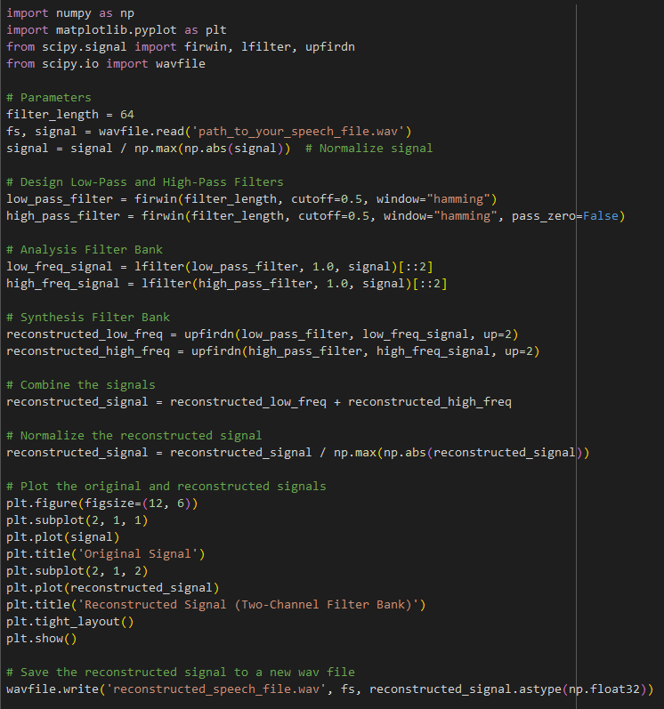
Two-Channel Filter Banks
Practical Implementation in Python

Slide 47
Two-Channel Filter Banks
Summary
Key Points
Two-Channel Filter Banks effectively decompose and reconstruct signals.
Balance computational efficiency and signal quality.
Widely used in various speech processing applications.
Future Directions
Development of more advanced filter designs.
Integration with machine learning for adaptive filtering.

Slide 48
Q & A

